Slide 1

UNIVERSITY INSTITUTE OF ENGINEERING
COMPUTER SCIENCE ENGINEERING
Bachelor of Engineering (Computer Science & Engineering)
Subject Name: Big Data Analytics
Subject Code: 20CST-471
Introduction to Map Reduce paradigm.
Mapped with CO2
Prepared By:
Er. Ankita Sharma
DISCOVER . LEARN . EMPOWER

Slide 2
Comparative analysis of Hadoop and Spark
A comparative analysis between Hadoop and Spark reveals distinctive features and advantages that cater to different needs within the realm of big data analytics. Hadoop, with its pioneering MapReduce paradigm, excels in batch processing and large-scale data storage, leveraging the Hadoop Distributed File System (HDFS) for distributed storage and YARN for resource management.

Slide 3
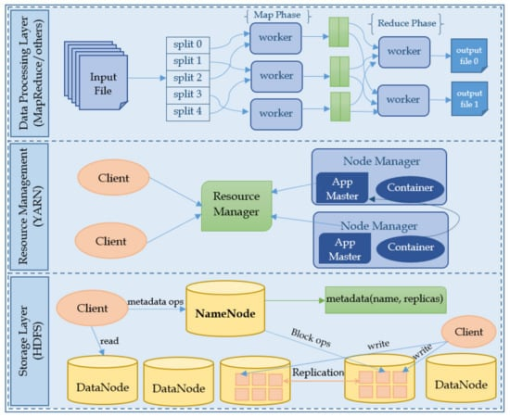

Slide 4
Both ecosystems boast vibrant communities and extensive ecosystems, yet the choice between them hinges on specific use cases, data processing requirements, and the evolving landscape of big data technologies.
In essence, Hadoop and Spark represent different paradigms, where Hadoop excels in established batch processing, and Spark emerges as a dynamic, multipurpose framework for diverse data processing challenges.

Slide 5
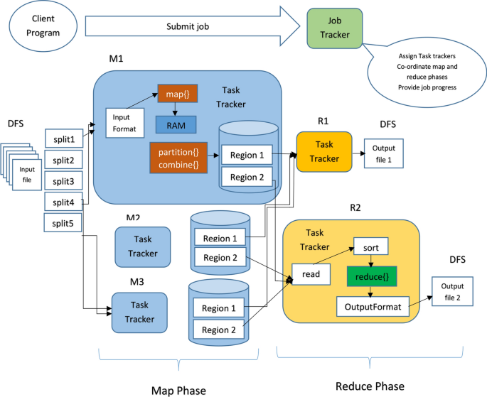

Slide 6
The comparative strengths of Hadoop and Spark become more evident when considering ease of use and programming models.
Hadoop, originally designed for batch processing, may involve more intricate coding for iterative algorithms, whereas Spark provides higher-level APIs in Java, Scala, Python, and R, enhancing user-friendliness. Spark's rich set of libraries, including MLlib for machine learning and GraphX for graph processing, further contributes to its appeal for developers and data scientists.

Slide 7
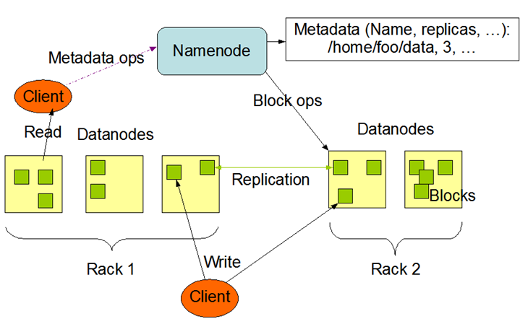

Slide 8
In terms of real-time processing, Hadoop was initially designed for batch processing and is less suitable for real-time analytics. Spark, however, shines in this aspect, supporting both batch and stream processing seamlessly. This flexibility makes Spark an ideal choice for applications requiring low-latency responses and real-time insights.
The fault-tolerance mechanisms of both frameworks differ as well. While Hadoop relies on data replication in HDFS for fault tolerance, Spark uses lineage information and RDDs for fault recovery, offering more nuanced and efficient fault-tolerance capabilities.

Slide 9
